Slide 1
Probability & Statistics
Rijah Khan
Cyber Security

Slide 2
Chapter 3
Measures of Central Tendency

Slide 3
Geometric Mean
The geometric mean is a statistical measure used to find the central tendency of a set of positive values.
It calculates the "average" by multiplying all values together and then taking the nth root of the product, where n is the number of values.

Slide 4
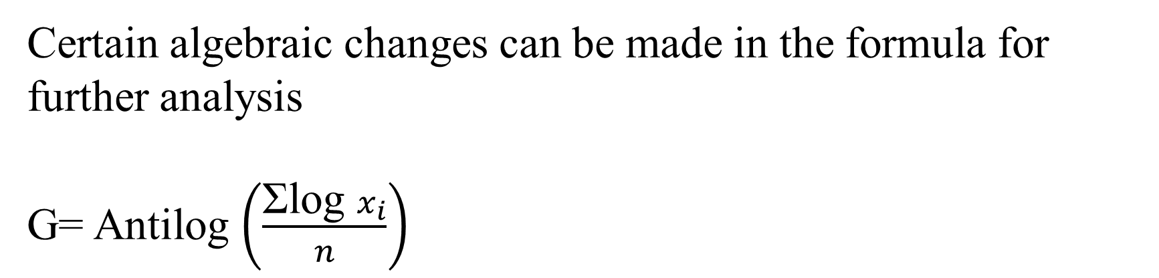
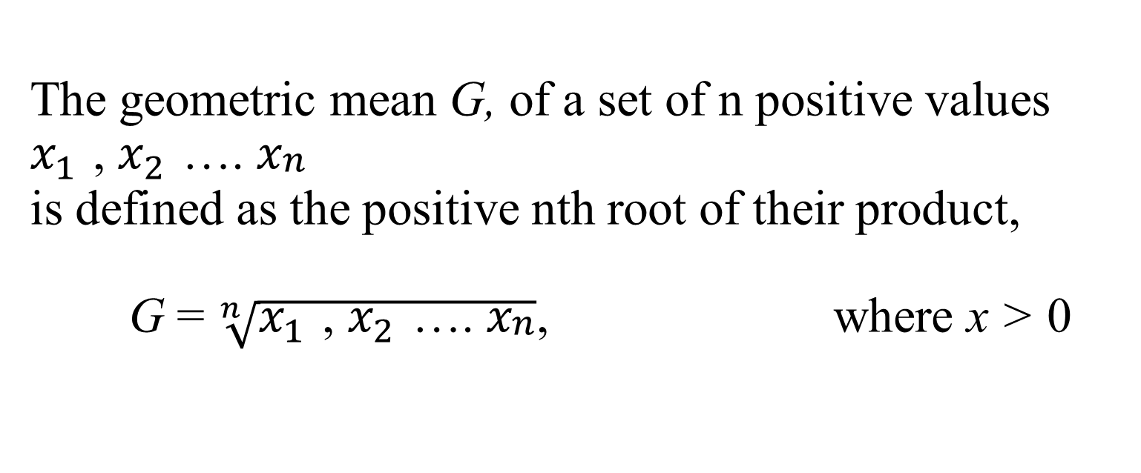
The geometric mean G, of a set of n positive values $x_{1 }$, $x_{2 }$…. $x_{\begin{aligned}n \\ \end{aligned}}$ is defined as the positive nth root of their product, G = $\sqrt[n]{x_{1 }\text{, }x_{2 }\text{…. }x_{\begin{aligned}n \\ \end{aligned}}}$, where x > 0
Geometric Mean for Ungrouped Data
Certain algebraic changes can be made in the formula for further analysis
G= Antilog $\left(\frac{\text{Ʃ}\text{log} x_{i}}{n}\right)$

Slide 5
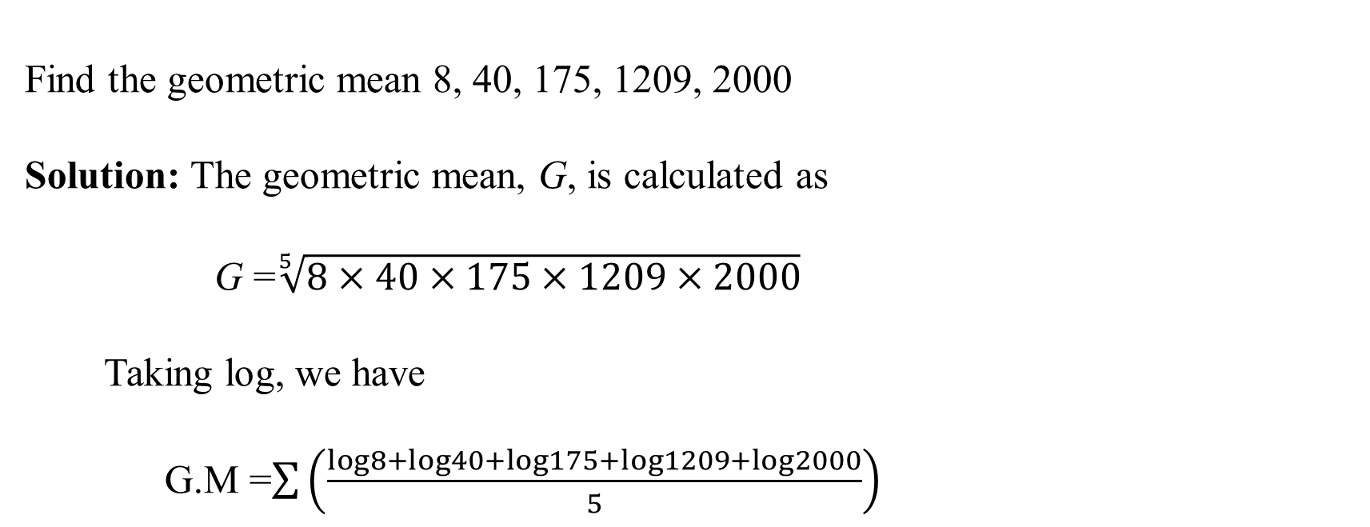
Example
Find the geometric mean 8, 40, 175, 1209, 2000 Solution: The geometric mean, G, is calculated as G =$\sqrt[5]{8×40×175×1209×2000}$ Taking log, we have G.M =$\sum{\left(\frac{log8+log40+log175+log1209+log2000}{5}\right)}$
G.M = 2.22632
G .M = Antilog (2.22632)
= 168.39

Slide 6

Formula: G.M = Antilog$\left(\frac{\text{Ʃ}f_{i} \text{log} x_{i}}{\text{Ʃ}f_{i}} \right)$
Geometric Mean for Grouped Data

Slide 7
Given the following frequency distribution of weights, calculate the geometric mean. Weight frequency 65-84 9 85-104 10 105-124 17 125-144 10 145-164 5 165-184 4 185-204 5
Example

Slide 8
Solution: Weight $x_{i}$ $f_{i}$ log$x_{i}$ $f_{i}$log$x_{i}$ 65-84 74.5 9 1.722 16.8498 85-104 94.5 10 1.9754 19.7540 105-124 114.5 17 2.0589 35.0013 125-144 134.5 10 2.1287 21.2870 145-164 154.5 5 2.1889 10.9445 165-184 174.5 4 2.2418 8.9672 185-204 194.5 5 2.2889 11.4445 Total ------- 60 -------- 124.2483

Slide 9

G.M =Antilog $\frac{\text{Ʃ}f_{i} \text{log} x_{i}}{\text{Ʃ}f_{i}}$ = $\frac{\text{124.2483}}{60}$ = 2.0708 G.M = Antilog (2.0708) G .M = 17.7 grams

Slide 10
Merits and Demerits of Geometric Mean
Merits of Geometric Mean:
It is based on observed value.
It is amenable to mathematical treatment.
It gives equal weightage to all observations.
It is an appropriate type of average to be used in case rates of change or ratios are to be averaged.
Demerits of Geometric Mean:
It is neither easy to calculate nor to understand.
It vanishes if any observation is zero.
In case of negative values, it cannot be computed at all.

Slide 11
Practice Questions Question 01: Calculate the geometric mean for the following data: (a) 0.35, 3, 30, 300, 3000, 0.3, 0.03, 0.0362, 0.00482, 58642 (b) 6.5, 169.0, 11.0, 112.5, 14.2, 75.0, 35.5, 215.0 Question 02: (a)For the following data find the geometric mean. Weights 60-80 80-100 100-120 120-140 140-160 160-180 180-200 (No.of apples) 5 14 17 10 1 0 2

Slide 12
(b) Find the geometric mean for the following data . Marks in percentage No. of Students 31- 40 28 41-50 31 51-60 12 61-70 9 71-80 5

Slide 13
Harmonic Mean
The Harmonic Mean (H.M.) is defined as “ A value that is the reciprocal of the mean of the reciprocals of a set of numbers”.
In other words, it is the reciprocal of the arithmetic mean and is calculated by taking reciprocal of the individual observations.

Slide 14
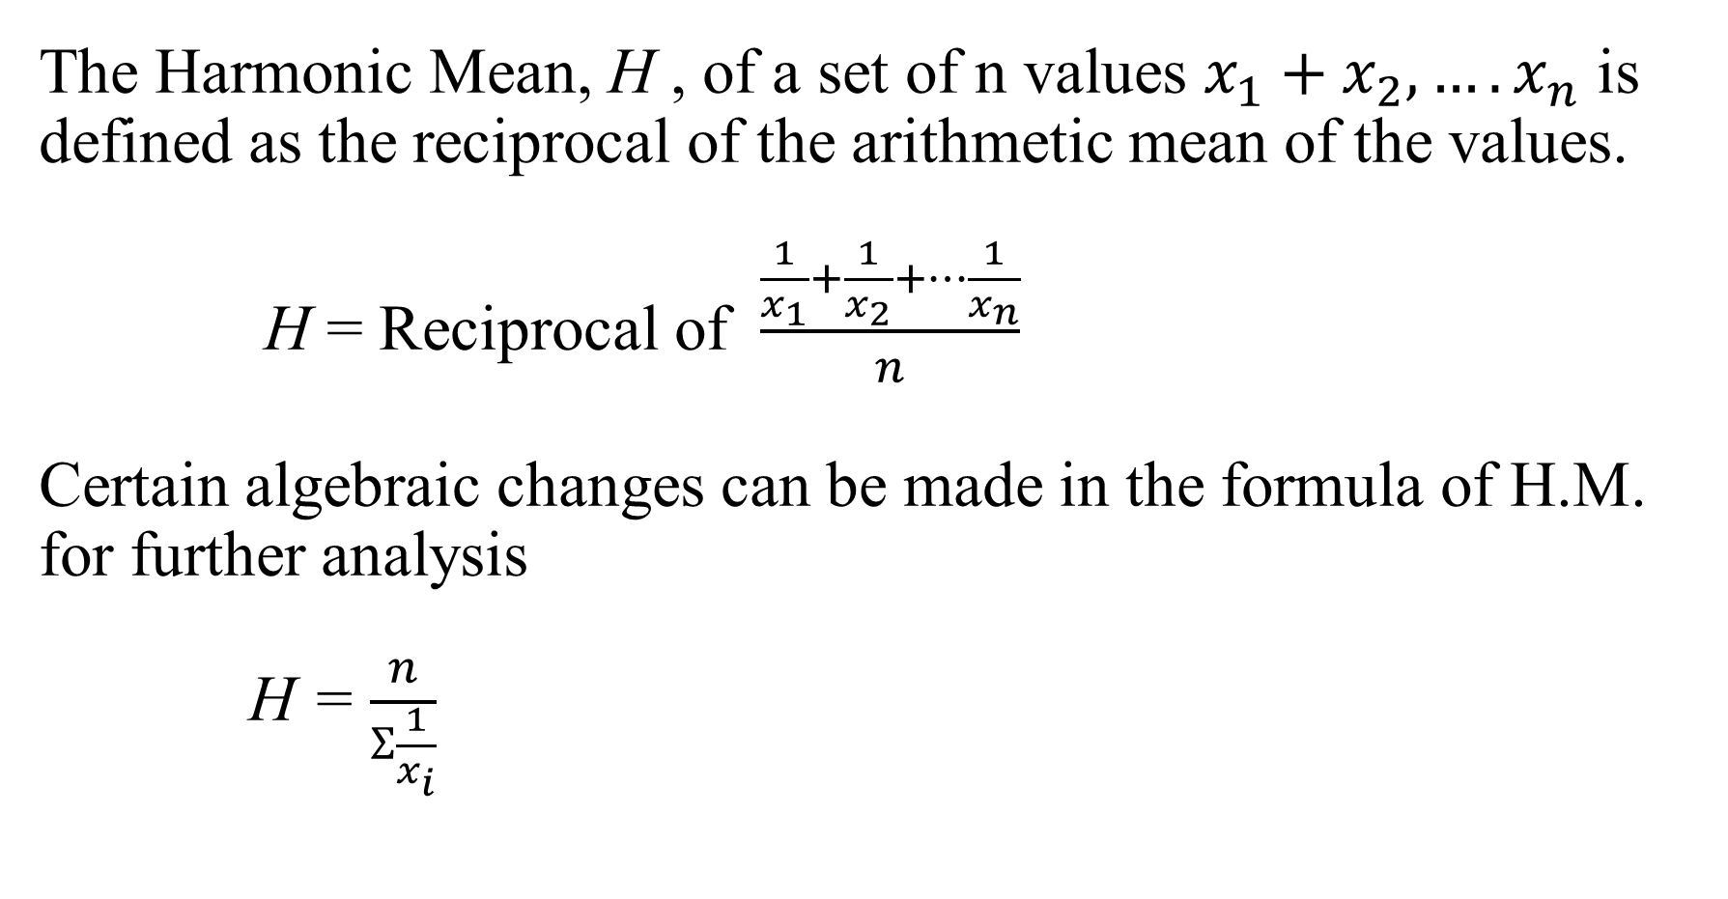
Harmonic Mean for Ungrouped Data
The Harmonic Mean, H , of a set of n values $x_{1}+x_{2},….x_{n}$ is defined as the reciprocal of the arithmetic mean of the values. H = Reciprocal of $\frac{\frac{1}{x_{1}}+\frac{1}{x_{2}}+…\frac{1}{x_{n}}}{n}$
Certain algebraic changes can be made in the formula of H.M. for further analysis
H = $\frac{n}{Ʃ\frac{1}{x_{i}}}$

Slide 15

Example
Find the Harmonic mean where x= 15,20,25. Solution: H = Reciprocal of $\frac{\frac{1}{15}+\frac{1}{20}+\frac{1}{25}}{3}$ = $\frac{3}{0.06667+0.5000+0.04000}$ = $\frac{3}{0.15667}$ = 19.15

Slide 16

Formula: H = $\frac{Ʃf}{Ʃf\left(\frac{1}{x_{i}}\right)}$
Harmonic Mean for Grouped Data

Slide 17
Find the Harmonic Mean from the following frequency distribution. Weights(grams) Frequency 65-84 9 85-104 10 105-124 17 125-144 10 145-164 5 165-184 4 185-204 5
Example

Slide 18
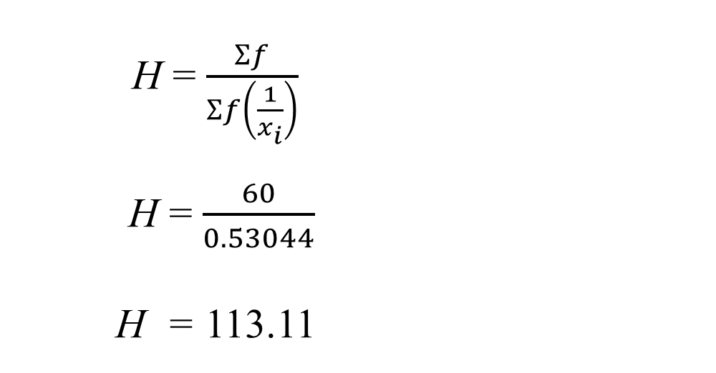
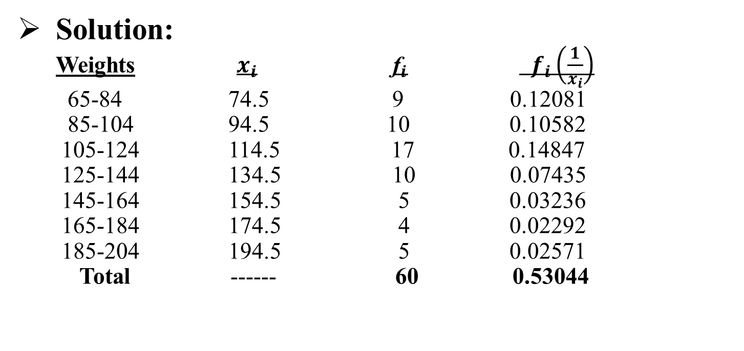
Solution: Weights $x_{i}$ ${\text{f}}_{i}$ $f_{i}\left(\frac{1}{x_{i}}\right)$ 65-84 74.5 9 0.12081 85-104 94.5 10 0.10582 105-124 114.5 17 0.14847 125-144 134.5 10 0.07435 145-164 154.5 5 0.03236 165-184 174.5 4 0.02292 185-204 194.5 5 0.02571 Total ------ 60 0.53044
H = $\frac{Ʃf}{\begin{aligned}Ʃf\left(\frac{1}{x_{i}}\right) \\ \end{aligned}}$ H = $\frac{60}{0.53044}$
H = 113.11

Slide 19
Merits and Demerits of Harmonic Mean
Merits of Harmonic Mean:
It is based on observations in the data.
It is amenable to mathematical treatment.
It is an appropriate type of average rate and ratios.
Demerits of Harmonic Mean:
It is not readily understood.
It cannot be calculated, if any one of the observations is zero.
It gives too much weightage to the smaller observations.

Slide 20
Practice Questions
Question 01: Calculate the harmonic mean for the following data: (a) 13.2, 14.2, 14.8, 15.2, 16.1 (b) 130, 135, 140, 145, 150
Question 02: (a) For the following data find the Harmonic mean. Marks 30-39 40-49 50-59 60-69 70-79 80-89 90-99 Frequency 2 3 11 20 32 25 7

Slide 21
(b) For the following data find the Harmonic mean. Hourly wages No. of persons 40-50 4 50-60 8 60-70 16 70-80 8 80-90 4

